Slide 1
chapter 4 Classification

Slide 2
In many situations, the response variable is instead qualitative In this chapter we discuss three of the most widely-used classifiers: logistic regression, linear discriminant analysis, andK-nearest neighbors.
We discuss more computer-intensive methods in later chapters, such as generalized additive models (Chapter 7), trees, random forests, and boosting (Chapter 8), and support vector machines (Chapter 9).

Slide 3
4.1 An Overview of Classification
Just as in the regression setting, in the classification setting we have a set of training observations (x1, y1), . . . , (xn, yn) that we can use to build a classifier. We want our classifier to perform well not only on the training data, but also on test observations that were not used to train the classifier.

Slide 4
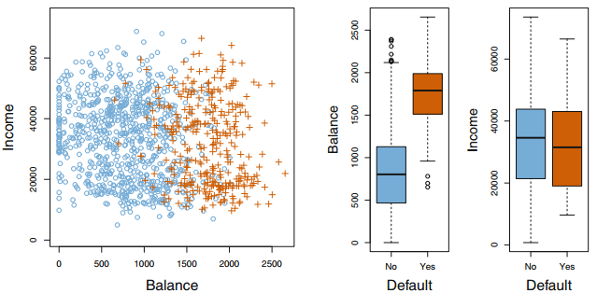

Slide 5

4.2 Why Not Linear Regression?
Using this coding, least squares could be used to fit a linear regression model to predict Y on the basis of a set of predictors X1, . . . , Xp. Unfortunately, this coding implies an ordering on the outcomes, putting drug overdose in between stroke and epileptic seizure, and insisting that the difference between stroke and drug overdose is the same as the difference between drug overdose and epileptic seizure.

Slide 6

Each of these codings would produce fundamentally different linear models that would ultimately lead to different sets of predictions on test observations.

Slide 7
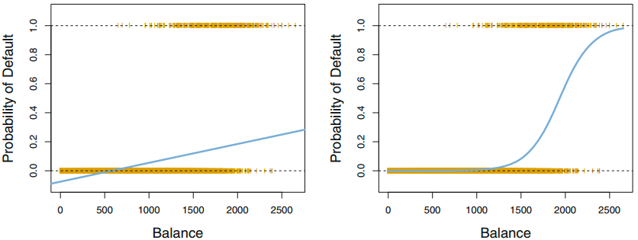
4.3 Logistic Regression
For the Default data, logistic regression models the probability of default.

Slide 8

4.3.1 The Logistic Model
For balances close to zero we predict a negative probability of default; if we were to predict for very large balances, we would get values bigger than 1. These predictions are not sensible, since of course the true probability of default, regardless of credit card balance, must fall between 0 and 1.

Slide 9



To avoid this problem, we must model p(X) using a function that gives outputs between 0 and 1 for all values of X. Many functions meet this description.

Slide 10
In a logistic regression model, increasing X by one unit changes the log odds by β1, or equivalently it multiplies the odds by e^β1
β1 does not correspond to the change in p(X) associated with a one-unit increase in X.

Slide 11

4.3.2 Estimating the Regression Coefficients
The basic intuition behind using maximum likelihood to fit a logistic regression model is as follows: we seek estimates for β0 and β1 such that the predicted probability pˆ (xi) of default for each individual, using (4.2), corresponds as closely as possible to the individual’s observed default status.

Slide 12

4.3.3 Making Predictions
One can use qualitative predictors with the logistic regression model using the dummy variable approach from Section 3.3.1.

Slide 13


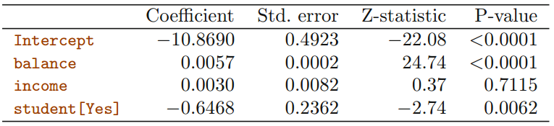
4.3.4 Multiple Logistic Regression

Slide 14
4.3.5 Logistic Regression for >2 Response Classes
In this setting, we wish to model both Pr(Y = 1|X) and Pr(Y =2|X), with the remaining Pr(Y = 3) = 1 − Pr(Y = 1|X) − Pr(Y = 2).

Slide 15
4.4 Linear Discriminant Analysis
We now consider an alternative and less direct approach to estimating these probabilities. In this alternative approach, we model the distribution of the predictors X separately in each of the response classes (i.e. given Y ), and then use Bayes’ theorem to flip these around into estimates for Pr(Y = k|X = x).

Slide 16
Why do we need another method, when we have logistic regression?
When the classes are well-separated, the parameter estimates for the logistic regression model are surprisingly unstable. Linear discriminant analysis does not suffer from this problem.
If n is small and the distribution of the predictors X is approximately normal in each of the classes, the linear discriminant model is again more stable than the logistic regression model.
Linear discriminant analysis is popular when we have more than two response classes.

Slide 17

4.4.1 Using Bayes’ Theorem for Classification
Let π_k represent the overall or prior probability that a randomly chosen observation comes from the kth class
Let f_k(X) ≡ Pr(X = x|Y = k) denote the density function of X for an observation that comes from the kth class.
We refer to p_k(x) as the posterior probability that an observation X = x belongs to the kth class.

Slide 18




4.4.2 Linear Discriminant Analysis for p = 1

Slide 19
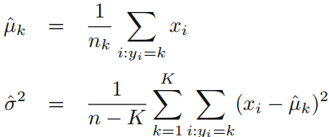



Slide 20
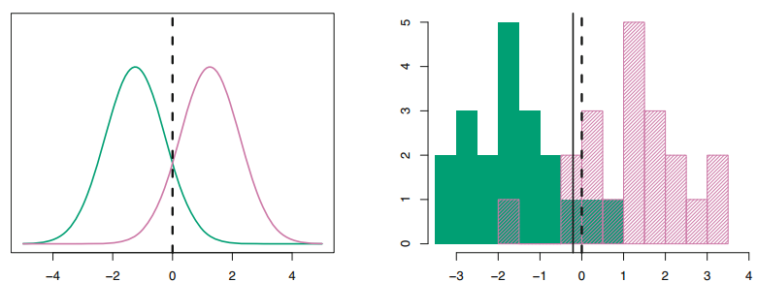

Slide 21



4.4.3 Linear Discriminant Analysis for p >1

Slide 22
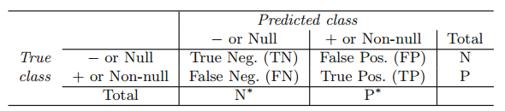
The ROC curve is a popular graphic for simultaneously displaying the two types of errors for all possible thresholds. The name “ROC” is historic, and comes from communications theory. It is an acronym for receiver operating characteristics.

Slide 23

4.4.4 Quadratic Discriminant Analysis

Slide 24
Why does it matter whether or not we assume that the K classes share a common covariance matrix?
The answer lies in the bias-variance trade-off. LDA is a much less flexible classifier than QDA, and so has substantially lower variance. This can potentially lead to improved prediction performance.

Slide 25
Code : Logistic Regression
library (ISLR )
names ( Smarket )
dim ( Smarket )
summary ( Smarket )
pairs ( Smarket )
cor ( Smarket [,-9])
attach ( Smarket )
plot( Volume )
glm.fit =glm ( Direction~Lag1+ Lag2+ Lag3+Lag4+ Lag5+Volume ,data=Smarket , family = binomial )
summary (glm.fit )
coef(glm.fit )
summary (glm.fit )$coef
summary (glm.fit )$coef [,4]

Slide 26
glm.probs = predict (glm.fit ,type ="response")
glm.probs [1:10]
glm.pred=rep ("Down" ,1250)
glm.pred[glm.probs >.5]="Up"
table (glm.pred , Direction )
(507+145) /1250

Slide 27
train =( Year <2005)
Smarket.2005= Smarket [! train ,]
dim ( Smarket.2005)
Direction.2005= Direction [! train ]
glm.fit =glm ( Direction~Lag1+ Lag2+ Lag3+Lag4+ Lag5+Volume ,data=Smarket , family = binomial , subset =train )
glm.probs = predict (glm.fit , Smarket.2005 , type ="response")
glm.pred=rep ("Down" ,252)
glm.pred[glm.probs >.5] = "Up"
table(glm.pred , Direction.2005)
mean(glm.pred==Direction.2005)

Slide 28
Code : Linear Discriminant Analysis
library (MASS)
lda.fit =lda ( Direction~Lag1+Lag2 , data=Smarket ,subset = train )
lda.fit
plot(lda.fit )
lda.pred= predict (lda.fit , Smarket.2005)
names (lda.pred)
lda.class =lda.pred$class
table (lda.class , Direction.2005)
mean(lda.class == Direction.2005)

Slide 29
Code: Quadratic Discriminant Analysis
library (MASS)
qda.fit =qda ( Direction~Lag1+Lag2 , data=Smarket ,subset = train )
qda.fit
qda.class = predict(qda.fit , Smarket.2005)$class
table (qda.class , Direction.2005)
mean(qda.class == Direction.2005)

Slide 30
Code : K-Nearest Neighbors
library (class)
train.X= cbind (Lag1 ,Lag2)[train ,]
test.X=cbind (Lag1 , Lag2)[!train ,]
train.Direction = Direction [train ]
set.seed (1)
knn.pred= knn(train.X, test.X, train.Direction ,k=1)
table (knn.pred , Direction.2005)
(83+43) /252

